Slide 1
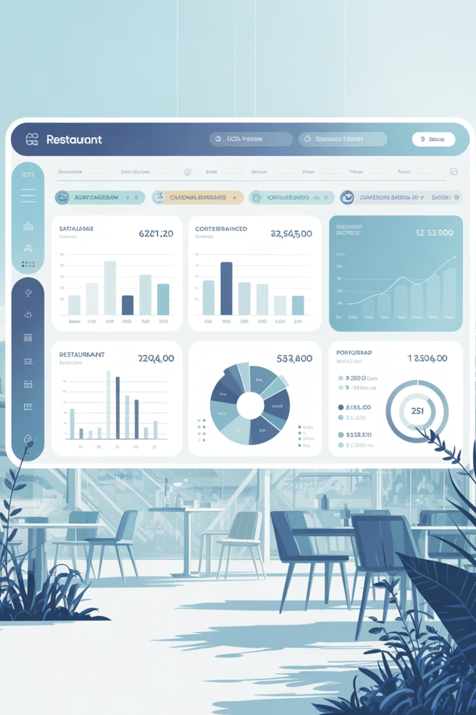
Infosys Springboard Virtual Internship 6.0
Food Trends: Understanding Customer Preferences Through Data
A comprehensive Power BI analytics project examining global restaurant performance patterns and customer engagement trends.

Slide 2

Project Objective
Transforming Restaurant Data into Strategic Insights
This project analyzes global restaurant data to understand customer engagement, rating reliability, cuisine demand, pricing behavior, and service availability using Power BI dashboards.
The objective is to convert raw restaurant data into meaningful insights that reveal performance patterns, customer participation trends, and strategic opportunities across global markets.

Slide 3


Global Restaurant Analysis
Why a Global Dataset?
Diverse Environments
Broader Patterns
Capture varied customer preferences across different regions and cultures
Analyze engagement and rating reliability beyond single location limitations
Pricing Structures
Understand diverse pricing strategies and market dynamics worldwide
Using Power BI, the dataset was cleaned and transformed into interactive dashboards that highlight global performance trends and support data-driven decision-making.

Slide 4
Four-Phase Development Approach
Core Dashboard Development
Data Collection & Preprocessing
Initial dashboards were developed to analyze customer engagement, restaurant ratings, cuisine popularity, pricing trends, and location-based performance patterns.
Restaurant data was collected from Kaggle and cleaned using Power Query. Missing values were handled, data formats were standardized, and derived columns were created to support meaningful analysis.
Strategic Insights
Advanced Analytics
Restaurants were categorized into action-based groups such as Promotion, Improvement, and Monitoring, converting findings into structured decision-making frameworks.
Advanced dashboards were created to evaluate rating consistency, customer participation, and the relationship between votes and ratings to assess reliability.

Slide 5
Data Foundation & Preparation
Dataset Source & Attributes
Preprocessing Steps
The dataset was sourced from Kaggle and includes comprehensive restaurant information:
Using Power Query, the dataset underwent thorough preprocessing:
Location and geographic details
Cuisine types and categories
Pricing structures and cost indicators
Customer ratings and vote counts
Service availability features
Handling missing and incomplete values
Correcting data types and formats
Removing unnecessary fields
Creating analytical columns such as vote buckets, quality classifications, and status indicators
This dataset enables multi-dimensional analysis of restaurant performance across global markets.

Slide 6

Navigating Project Challenges
Data Quality Issues
Incomplete and inconsistent data were managed through careful cleaning and validation processes. Multiple data sources required standardization to ensure accuracy.
Power BI Complexity
Complex filter interactions and calculated measures were handled systematically, especially while analyzing rating reliability and customer engagement patterns.
Visualization Design
Appropriate visuals were selected to clearly represent relationships between votes, ratings, and performance metrics for effective stakeholder communication.

Slide 7
Skills Developed & Outcomes
Technical Competencies Enhanced
Strategic Insights Gained
Data preprocessing in Power BI
Dashboard development and visual storytelling
Analytical thinking and pattern recognition
Interpretation of performance metrics
Understanding the influence of ratings, votes, pricing, and services on restaurant performance
Ability to convert raw data into actionable insights
Framework for data-driven decision-making

Slide 8

Key Findings & Strategic Implications
Engagement Drives Reliability
Restaurants with higher vote counts show more stable and trustworthy ratings, indicating genuine customer satisfaction.
Cuisine & Pricing Impact
Customer interaction is strongly influenced by cuisine preferences and pricing strategies, affecting overall engagement levels.
Service Features Matter
Online delivery and accessibility features increase engagement and market reach significantly across all segments.
Regional Variations
Significant performance differences across locations highlight the need for localized strategies and targeted marketing.

Slide 9



Future Vision & Enhancements
Real-Time Data Integration
Predictive Analytics
Advanced Recommendations
Incorporating live data feeds to enable continuous monitoring of restaurant performance and real-time trend detection.
Implementation of machine learning models to forecast customer behavior, rating trends, and demand patterns.
Development of intelligent recommendation engines to improve decision-making and performance evaluation accuracy.
These enhancements aim to transform the project into a dynamic, intelligent system that adapts to market changes and provides forward-looking insights.

Slide 10


Conclusion – Data-Driven Restaurant Intelligence
Key Takeaway
Combining technical execution with strategic thinking creates actionable insights that drive meaningful business outcomes.
This project demonstrates how structured restaurant data can be transformed into meaningful insights through effective preprocessing and visualization.
By analyzing customer engagement, ratings, cuisine trends, pricing, and service availability, the dashboards provide a comprehensive view of restaurant performance across global markets.
The integration of analytical logic with visualization supports data-driven decision-making and strategic prioritization.

